Slide 1
DRONE - RESEARCH

Slide 2
Components
Structural Calculations
Assembly
Lawa & Regulations
Indian Industry
Drones are usually associated with military applications. Some of the most common uses for drones include intelligence gathering, anti-aircraft target practice, and weapons platforms. However, there are plenty of other non-military applications that drones are used for or will be used for in the future. They include:
Agriculture
Delivery services
Photography/videography
Recreational use
Search and rescue
Security surveillance
Traffic monitoring
Weather monitoring

Slide 3
Components
The majority of mid-level to high-end drones generally consist of the same parts. These parts include:
Accelerometer
Antenna
Altimeter
Battery
Camera
Electric speed controllers
Flight controllers
GPS module
Receiver
Sensors (ultrasonic and/or collision avoidance)
Power distribution board (if not included in/with the frame, PDB for short)
Battery adapter (to be soldered onto the PDB to enable you to simply plug/unplug your battery)
one of the essential parts of the racing drone, besides the camera, is the FPV goggles. These are connected to the drone’s camera and control station, so that the pilot can see in real time the images that the camera is capturing, with a first-person view.
add-ons include motor mounts, independent arms, motor and gimbal control unit, among others. But parts that are not useful for racing, such as GPS systems or sensors, are omitted.
similar features for delivery, search and rescue, photography drones.
Agricultural drones include the basic parts of a drone, such as the frame, camera, sensors, GPS and battery. However, the cameras used in agriculture are usually not the traditional ones. They are usually equipped with multispectral cameras, which sense different spectrums of light to detect pests or diseases in crops, identify areas of water stress and provide specific information to help manage crops more efficiently, which helps improve productivity and reduce costs.
similar features for weathering (in place of GPS, the DHT sensor is utilized to acquire weather data, specifically humidity and temperature) and traffic.
Crystal-controlled clock oscillators (XO) are critical for communications and microprocessor timing.
Inductors are used to deliver clean DC power, which is critical for processing data, video, and communications.
Temperature compensated crystal oscillators (TCXO) are used for GPS and radio transmissions to and from the drone. These electric components are especially important when it comes to GPS because the timing and signal need to be accurate to calculate longitude and latitude. Essentially, the better the timing solutions, the better the GPS system is going to work.
Some drones also navigate according to global navigation satellite systems (GNSS), which means they too require accurate timing solutions incorporated into their SDR time board. Specifically, the internal time board uses an oven-controlled crystal oscillator (OCXO) because it delivers a stable and accurate signal, low noise floor, low phase noise, and high frequency stability.

Slide 4
The frame or chassis is the body of the drone and is the component that serves the function of holding all the parts together.
The arms of a drone are the components that support the motors and are attached to the frame or base structure of the drone. Long arms offer greater stability, while short arms allow for better maneuverability.
The motors do not have the capacity to lift the drone on their own, as they must be connected to propellers that are in charge of rotating to provide lift to the drone. Therefore, each motor has one or two propellers that together make up the powertrain.
Most drones have a pair of standard propellers, which rotate counterclockwise, and a pair of reverse propellers. This provides greater stability during flight.
the most common are Li-po batteries
drone flight controller is responsible for receiving and recording all the information coming from the controller, the geolocation system, the sensors and other interconnected elements, while sending the necessary signals to control the drone’s movements during flight. the compass, gyroscope and sensors, are usually located on this board.
Speed sensor: This allows the speed at which the drone is moving to be determined by interpreting the air pressure impacting the device.
Height and altitude sensors: these sensors use pressure variation to detect how high the drone is flying in relation to the ground, and its position in relation to sea level. This data is of great importance in order to maintain the maximum altitude at which a drone can fly, in accordance with current drone regulations.
Position sensors: these allow the drone’s position to be known in real time, through connectivity with GPS or any other global positioning system.
body of the drone usually has the necessary structure to install a camera on its base
GIMBAL essential for stabilizing the camera during drone flight. It is a complement that is placed between the frame and the camera, to prevent the vibrations of the motors from affecting the quality of the images captured with the drone.
This is one of the parts of a drone necessary to make professional aerial recordings.
ESC (Electronic Speed Controllers). These components help to improve the flight experience, as they allow you to vary the speed and direction in which the drone moves
The control station usually consists of 3 elements or controls of a drone, including the radio transmitter and receiver, the data management components and the remote control.
landing gear is a structure that goes on the bottom of the drone, which allows you to maintain an adequate distance between the body of the drone and the ground.

Slide 5
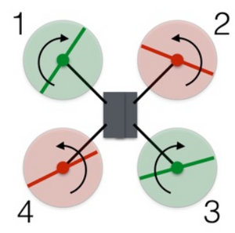
Structural Calculations
https://uav.jreyn.net/quadcopter-design/step-3-static-thrust-and-power
a monocopter, one propeller instead of four. When you turned the throttle up to spin the motor faster and generate lift the propeller would spin around but the body of your copter would too! The body is experiencing the same torque as the propeller. This conundrum was solved long ago with the arrirval of the helicopter. That small rotor on the back creating a lift force at a radius down the tail of the copter (torque) to oppose the torque of the main rotor producing upward lift. But helicopters are mechanically complex.
If you mount a second motor turning at the same speed, the torques on the copter body cancel and you are left with a non-twisting ascending copter body. But you still need at least a third motor to achieve three degrees of rotational freedom. The most common design currently is the quadcopter. Here two spinning motors are counter balanced by two other spinning motors. The simplicity of build requies a more robust control system. A quadcopter has six degrees of freedom (3 translational and 3 rotational) but only 4 inputs, the 4 motor speeds.
a PROPELLER is essentially just a spinning airfoil. Instead of a fixed wing craft moving forward to generate air flow over an airfoil (wing), a helicopter spins its airfoils (propellers) through the air to generate lift. the rotor pushes down on the air, the air pushes up on the rotor. The faster the rotors spin, the greater the lift, and vice-versa.
two sets of rotors rotating in opposite directions, the total angular momentum is zero. decrease the angular velocity of rotor 1 such that now it has an angular momentum of -1 instead of -2. If nothing else happened, the total angular momentum of the drone would now be +1. Of course, that can't happen. So the drone rotates clockwise so that the body of the drone has an angular momentum of -1. Decreasing the spin of rotor 1 did indeed cause the drone to rotate, but it also decreased the thrust from rotor 1. Now the net upward force does not equal the gravitational force, and the drone descends. Worse, the thrust forces aren't balanced, so the drone tips downward in the direction of rotor 1. To rotate the drone without creating all those other problems, decrease the spin of rotor 1 and 3 and increase the spin for rotors 2 and 4. The angular momentum of the rotors still doesn't add up to zero, so the drone body must rotate. But the total force remains equal to the gravitational force and the drone continues to hover. Since the lower thrust rotors are diagonally opposite from each other, the drone can still stay balanced.
increase the rotation rate of rotors 3 and 4 (the rear ones) and decrease the rate of rotors 1 and 2. The total thrust force will remain equal to the weight, so the drone will stay at the same vertical level. Also, since one of the rear rotors is spinning counterclockwise and the other clockwise, the increased rotation of those rotors will still produce zero angular momentum. The same holds true for the front rotors, and so the drone does not rotate. However, the greater force in the back of the drone means it will tilt forward. Now a slight increase in thrust for all rotors will produce a net thrust force that has a component to balance the weight along with a forward motion component.
Rotation and lateral movement happens in direction of lower propeller thrust.
1 and 3 reduced = rotate clockwise,
2 and 4 reduced = rotate counter-clockwise
1 and 4 reduced = move left,
2 and 3 reduced = move right,
1 and 2 reduced = move forward,
3 and 4 reduced = move backward

Slide 6
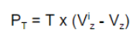
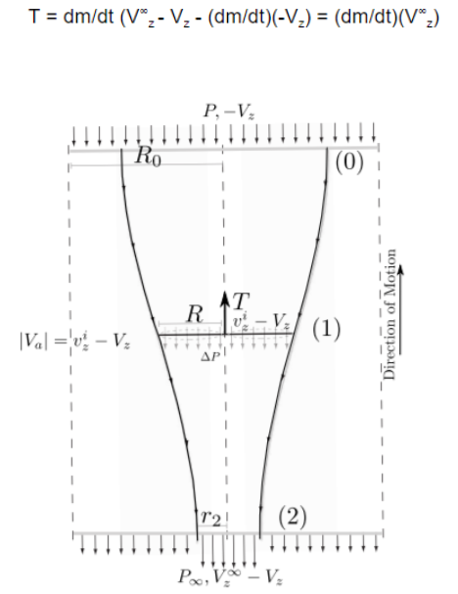
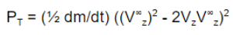
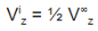
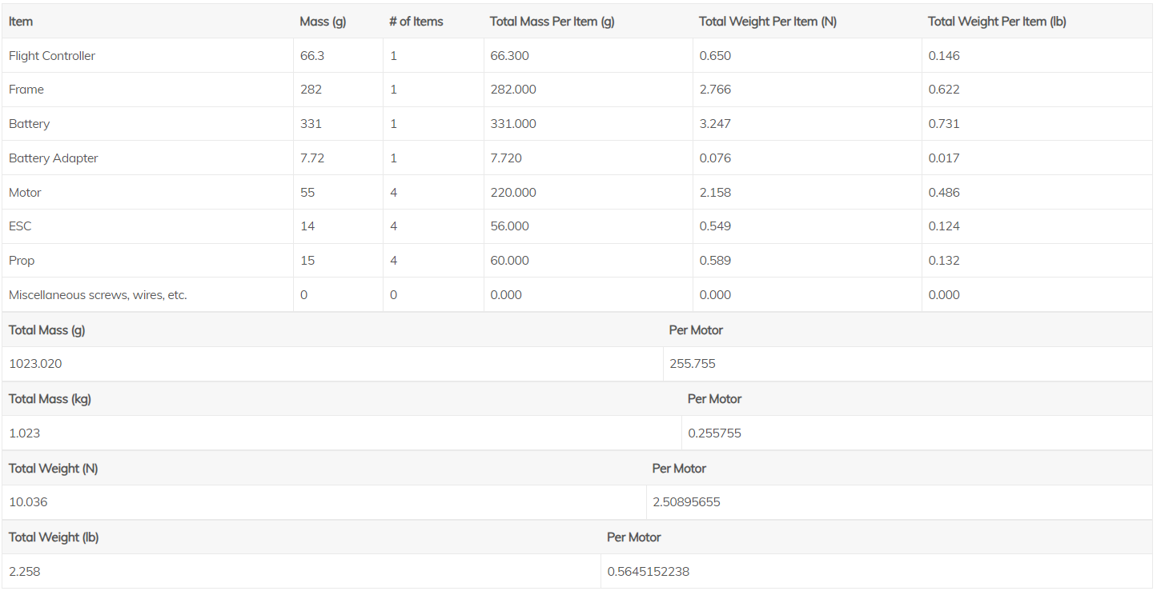
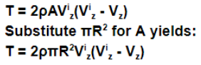
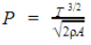
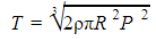
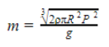
one method of control is PID (Proportional, Integrative, Derivative) control. This type of control receives a desired state as input and applies a response to obtain an output. The response is governed by the error feedback (the difference between output and input). The proportional component applies a response based on the amount of error (It looks at the present.). The integrative portion applie a response based on the amount of error over time (It takes an integral to look at the past basically.). And the derivative portion applies a response based on the rate of change of the error at that instant. (It takes a derivative in order to look into the future basically.).
Power is the rate of kinetic energy imparted across the streamtube and is equal to thrust multiplied by local air velocity.
Thrust is the difference between the momentum of the flux going out and the momentum of the flux coming into the propeller "streamtube".
Power in these equation refers to the power as a rate of energy per time expended producing lift. It is lifting power if you will. Not to be confused with electrical power from a battery or even mechanical power from a motor. There are 3 stages of power in a quadcopter. Electrical power from a battery that is translated to mechanical power by a motor subject to motor efficiency. And that mechanical power at the shaft of the motor is translated into what we may call lifting power by the propellers subject to that propeller's figure of merit (a fancy term for the efficiency with which a propeller translates mechanical rotational power into lifting power). Keep in mind the three types of power because the distinctions are absolutely critical to maximizing flight time.
At hover Vz is equal to zero.
at hover the thrust will be equal to the weight of the quadcopter (the product of the mass and "g").
where P is mechanical power from a motor driving a propeller at some rotational speed n rotations per minute divided by 1000 and C is some constant related to a specific propeller
where Prop Constant and Power Factor are constants related to a specific propeller and Power Factor being a number close to 3 (P and n are unchanged)

Slide 7
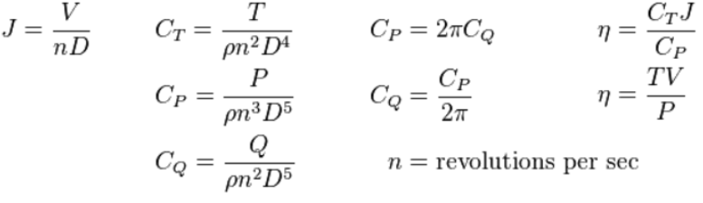
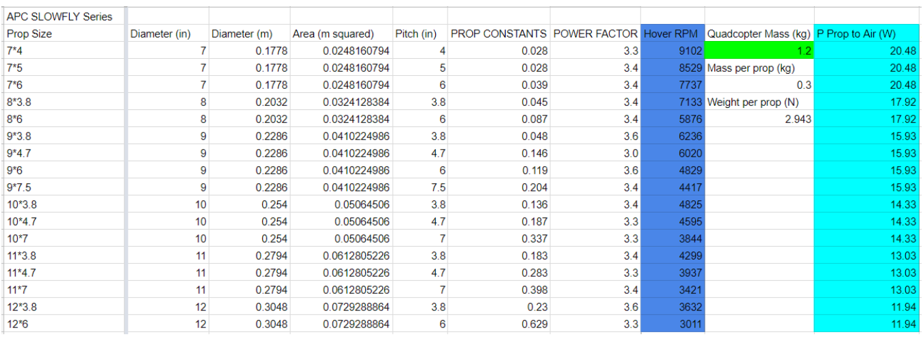
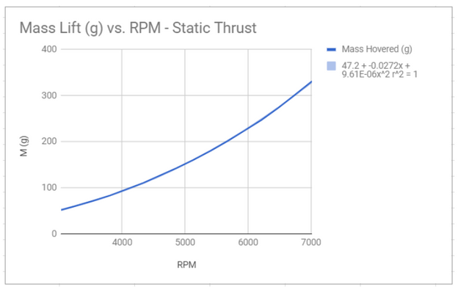
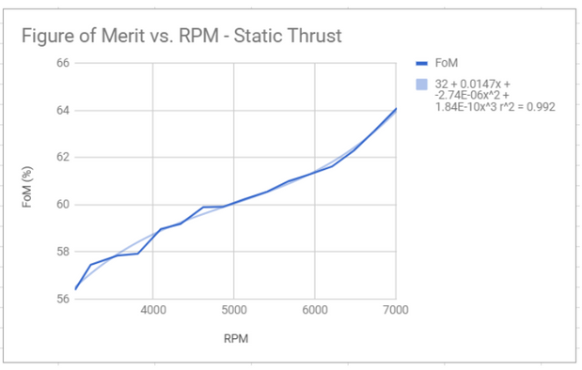
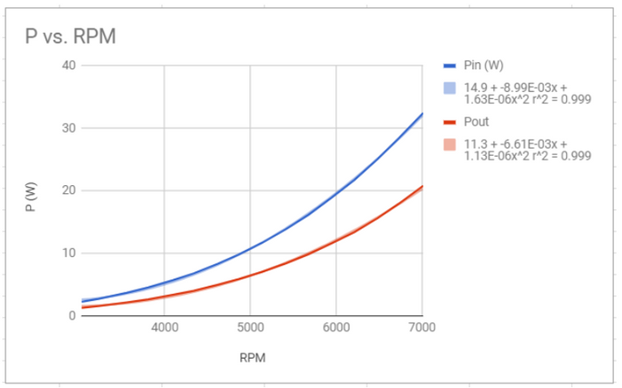
very rough estimate you can assume a figure of merit of 50%
J - Advance ratio (A fancy term that accounts for if a propeller is moving relative to a coordinate plane - not to be confused with the velocity of the air passing through the prop area even at a hover)
Cp - Coefficient of power
Ct - Coefficient of thrust
Cq - We won't concern ourselves with it here. But feel free to look into it.
Regular n - rotational speed
Fancy n - Figure of merit
ρ - density of air
D - Propeller diameter
V - Local air velocity in streamtube
T - Thrust
P - Mechanical power supplied to turn propeller
A plane doesn't need to produce as much thrust with it's propeller to fly. This is readily reasoned by considering its inertia. A plane's inertia contributes to its lift in that the mass of the plane moving forward through the air is the mass concerned in inertia and producing lift across the wings. However in a quadcopter (we have to skip to rotational inertia here rather than translational) the inertia for lift is governed in that the propeller must continue turning to produce lift, and at a much higher rate of speed than that of a large wing moving throught the air for a plane of the same weight. Remember that the larger the airfoil the lower the air speed needs to be.

Slide 8
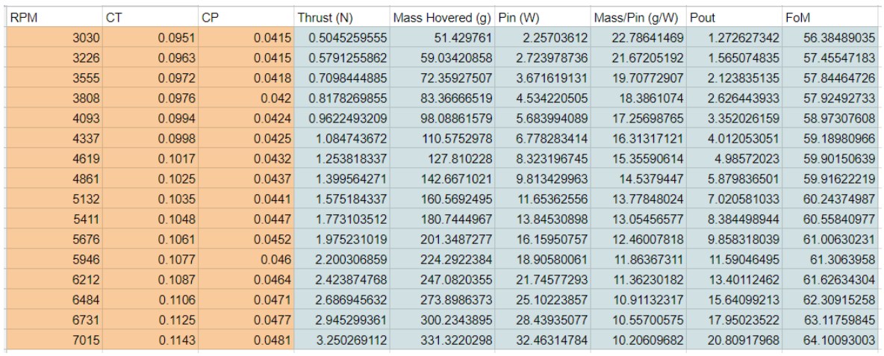
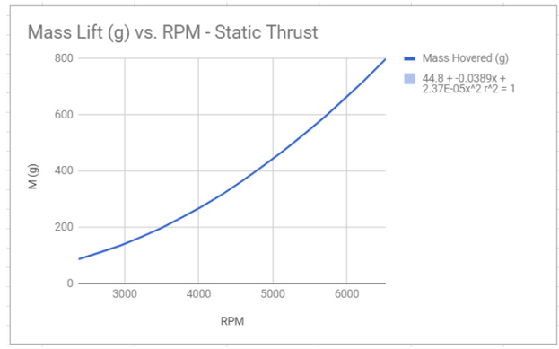
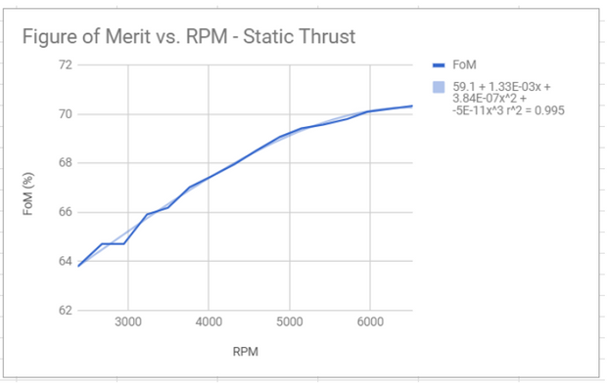
8 X 3.8 slow flyer
It doesn't make sense that the FoM does not show much sign of leveling off and eventually dropping as rotational speed increases. One would at least guess that a peak should occur. This suggests the dataset to be too small.
We already mentioned that the data we just looked at wouldn't help us with a quadcopter heaving than about 1.2kg. At this point one would at least guess that we may want to spin the prop faster to lift the a heavier quad. But then we must stop to consider what the maximum allowable rotational speed of a propeller is - especially one that is labled SF for "Slow Fly" like those common APC propellers are. So the bottom line is that the data here, though fantastic, is lacking.
10 inch diameter SF propellers
copy over the static test data for Ct, Cp and RPM into a column each. UIUC assigns for Cto and Cpo respectively for the static case. assign output columns with the formulas for Ct and Cp above solved for thrust (T) and power (P). Also assign a column and calculate the corresponding mass hovered by dividing thrust by g for a more relatable quantity of lift. Next assign an output column using our prior formulation for power. Use the calculated thrust column as an input for this column. Remember that lifting power is equal to the product of lifting thrust and air velocity (TV). Simply divide TV by P and multiply by 100 to convert the fraction to a percentage for figure of merit.

Slide 9
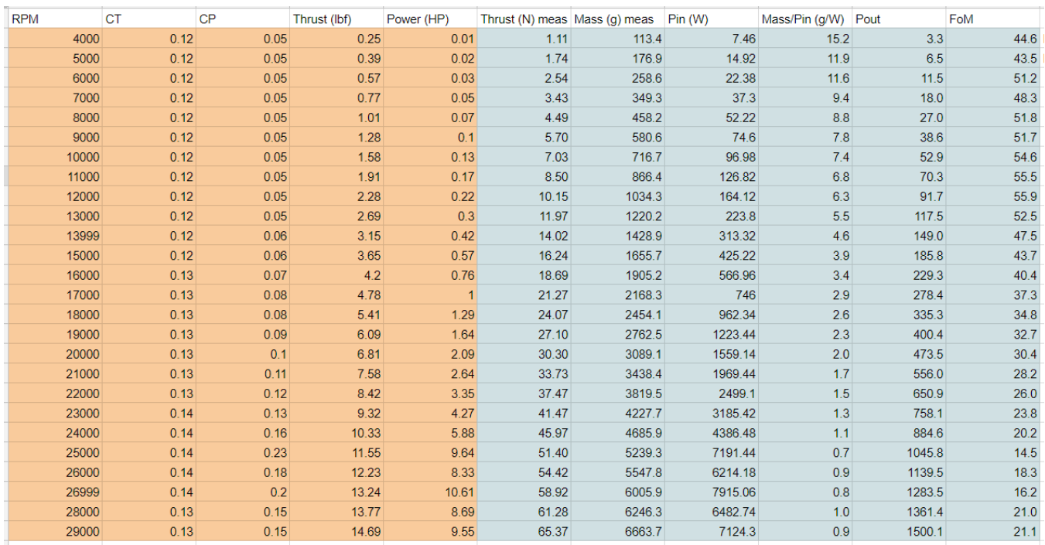
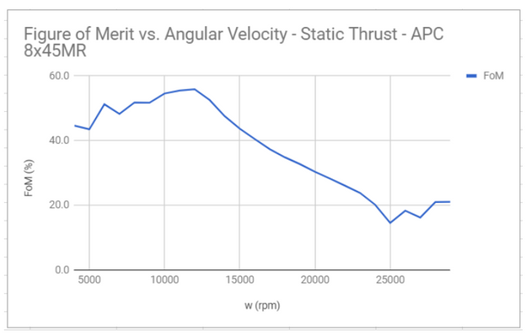
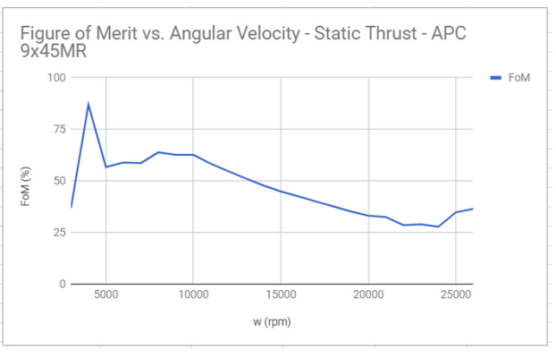
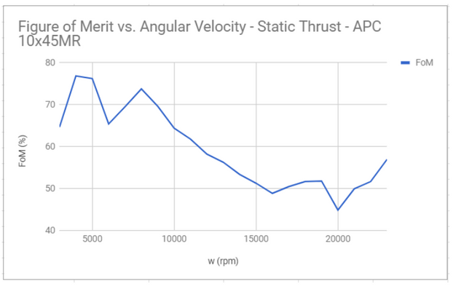
8x45 multirotor propeller
Define a preliminary mass for your quadcopter.
Set up an equation to solve for rotational speed necessary to hover that mass for multiple propellers based on Momentum Theory as detailed previously.
Set up graphs including rotational speed, thrust, mechanical power, lifting power, and FoM for different propellers based on empirical data.
Find the rotational speed necessary to hover that mass based on this empirical data and then compare against your initial calculations as a check.
Compare propellers to find the one which will hover your quadcopter at the highest FoM value.

Slide 10
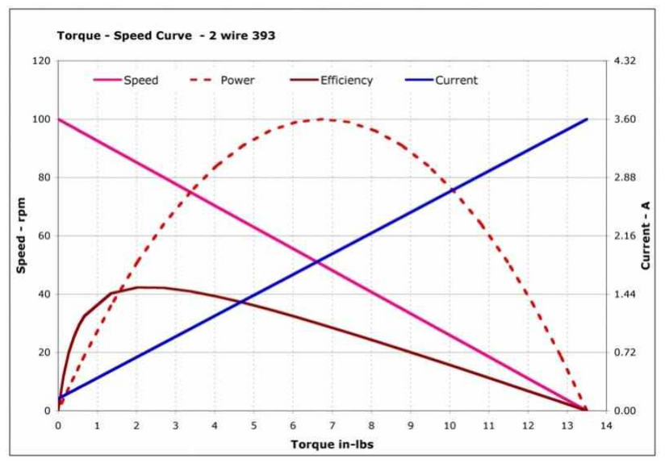
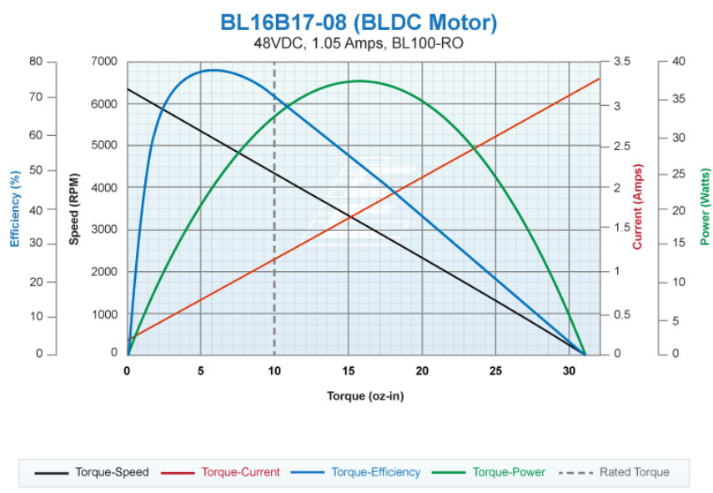
A coil is subject to a magnetic field. When a voltage is applied to that coil, the coil experiences a a force causing it to rotate according to one of the many electrogmagnetic "right hand rules". F = ILBsin(angle between length of wire and magnetic field direction). Now imagine you connect a voltage and the coil is subjected to a force per above. Eventually the current direction relative to the magnetic field vector will flip causing an increasing (sine function) opposing force. This reversal means the motor won't be able to continue spinning! To counteract this reversal, add a commutator. This device flips the polarity of the voltage across the coil so that the motor will always experience forces in the same direction.
The force (and thus the accerlation or speed) or the MOTOR is increased by increasing the voltage. The relating equation for this relationship is defined as Angular Speed = Kv * V where Kv is a constant for that specific motor.
commutator is an additional point of failure. Over time the brushes will wear out and the performance of the motor will suffer as a result.
Brushless DC Motors - BLDC for short. BLDC motors tend to be more expensive for multicopters but more reliable and efficient over its brushed counterpart. A BLDC motor trades out a commutator for electronic position control. This control is called PPM or Pulse Position Modulation.
the only moving part is the rotor. A controller applies voltage in sequence to a number of poles. Speed is again controlled by the magnitude of the applied voltage (so really there is pulse width modulation PWM enveloped here) but the rotation must be governed by PPM.
Brushed motors are only really worth it when you are trying to build a small, budget multirotor.
The first observation to make from a torque speed curve is that speed decreases as torque increases.
the size of the load is inconsequential. The same load could stall a bigger or small motor too perhaps but at different torques!
mechanical power produced by a motor is equal to the product of its torque and angular speed. On a torque speed curve, you will notice that this is visualized as the "area under the curve". Notice that the area under the curve will be greatest when the motor is running at half of its no load speed.

Slide 11
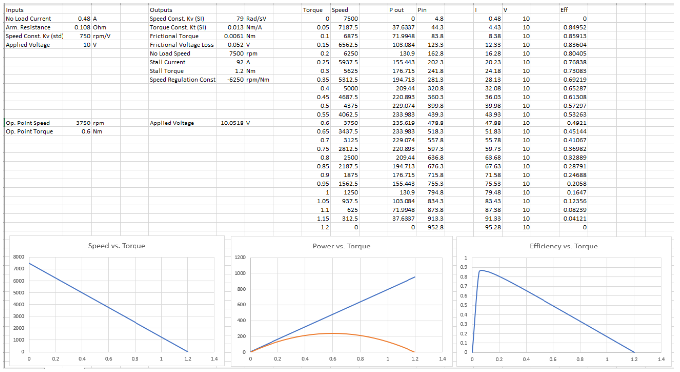
A perfectly efficient motor would produce just as much mechanical power as the electric power it consumes. Notice that peak efficiency does NOT occur at peak power. Once the motor has reached peak efficiency, there is diminishing returns should you operate the motor to either side of it. This means that should you increase the mechanical power to reach peak power you will have to increase the electric power by more!
By operating point we mean the point on the torque speed curve that defines a motors performance. This is an important term to understand because different propellers will have different operating points when they hover quadcopters. The operating point will also change with a change in weight - if add a payload - to the quadcopter. This brings us to matching a motor to a propeller.

Slide 12
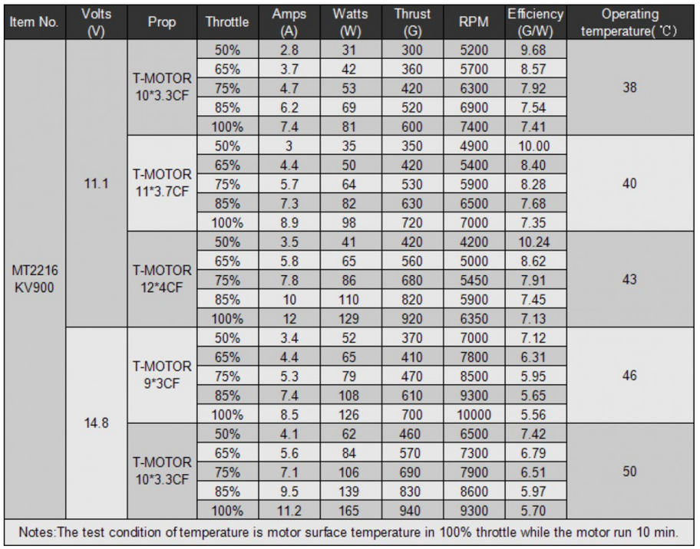
consider the table for the APC 8x4.5MR propeller. Pretend that you want to hover a quadcopter with a mass of roughly 1.4kg. This requires each motor to lift roughly 350g. Referring to the table, we notice that a rotational speed of 7000rpm and mechanical power of 37.3W is required to hover. This gives us an operating point. Simply divide the power by the speed and you get the necessary torque.
Now that we have an operating point, we then need to research motors that can function at this operating point. First, make a plot area for a torque speed curve. Next, put a dot at the torque and speed of your operating point. Next, you need to draw a torque speed curve for a motor (or superimpose one) onto this plot area. Pick a voltage that gives a no load speed well above the operating point such that the point is below the curve. Next, slide the line to the left until it touches the operating point dot. Divide the speed by the kv constant to get the operating voltage. Finally, look at the corresponding point on the efficiency curve. This is the point of optimization for our quadcopter where we stressed flight time. Different motors will have different curves and the operating point will land at different places along those curves. You want to find a motor where the operating point is the closet to the operating point of peak efficiency. This is the ideal motor for a quadcopter that doesn't need fast response times and is looking to maximize flight time.
You should design your quadcopter to be capable of producing enough thrust to hover a quadcopter of twice the weight of what yours is. You need this buffer for climbing, manuevers, and flying in windy conditions. Note also the efficiency given in grams per Watt. This definition of efficiency is also referred to as specific thrust and specific thrust is the better term and fairly common in multirotor design and it actually relates lifting thrust to electrical power. Unlike normal efficiency which always maxes out at 100%, specific thrust technically has an infinite limit. Basically as a propeller blade becomes infinitely long, the power necessary to achieve some specified amount of lift becomes infinitely small and thus the specific thrust becomes infinitely large. Specific thrust is very useful however when you consider a defined case.
T-motor MT-2216-11 motor thrust table
consider the row for an APC 8x3.8SF propeller in the spreadsheet that calculates required rpm and lifting power that showed earlier for P Prop to Air calculation. To get the ideal specific thrust for any propeller of an 8 inch diameter (momentum theory derivation of power depends on diameter but not pitch and pitch came up later when calculating mechanical power) then we simply divide 300g by 17.9W and obtain an ideal specific thrust of 16.7 g/W. So obviously you want to get a specific thrust for an 8 inch propeller lifting 300g as close to 16.7 g/W as possible. If we consider the APC 12x3.8SF propeller then the ideal specific thrust would be 25.1 g/W and so on. Of course, you should compare the thrust tables as best you can against the calculations developed earlier. If we adjust our spreadsheet to assume a mass per motor of 420g the ideal specific thrust drops to 21.2 g/W.
Now we can compare it to the T-motor table for the 12x4CF propeller. assuming a hover at 50% throttle, the specific thrust is 10.24 g/W, roughly 48% of ideal. the rotational speeds are both shown to be 4200rpm! Now how would we get from the 41W of electrical power to the 19.8W of lifting power? Let's assume a great motor efficiency of 80%. That leaves us with 32.8W of mechanical power. Dividing the lifting power by that mechanical power and you're left with an FoM of about 60%. a very reasonable value for FoM!
The thrust data is based on using not only certain propellers, but T-motor carbon fiber propellers. their carbon fiber propellers are simply not worth buying for our quadcopter design because we are trying to push flight performance with a heavy restriction on budget. the thrust data must be taken with a grain of salt because the performance of different propellers can vary greatly from prop to prop. Most likely the motor efficiency was below 80% and the propeller FoM was about 60% though.

Slide 13
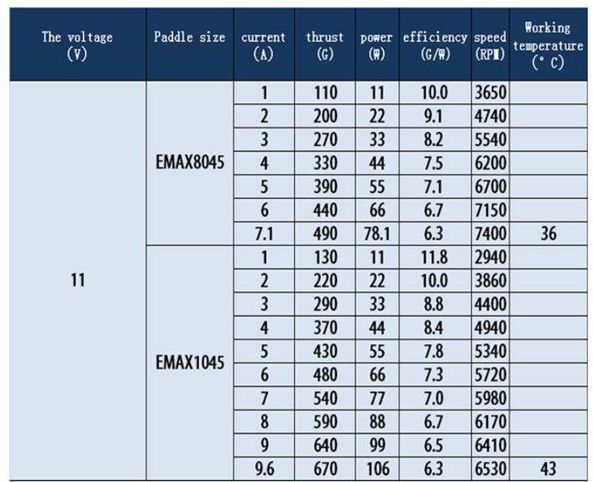
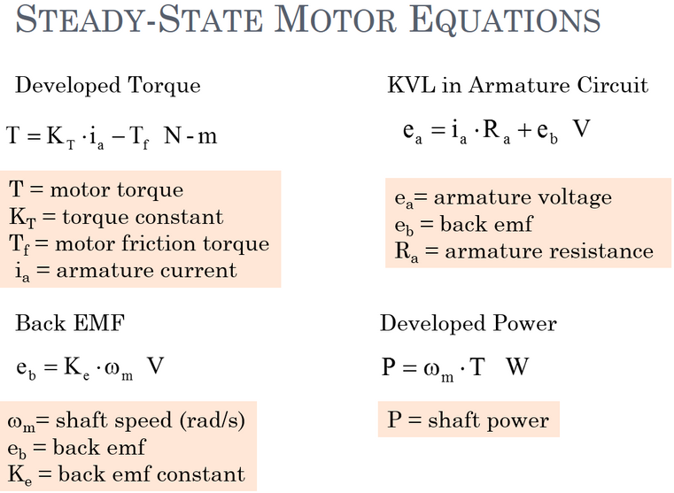
Emax MT2213
to hover a mass of 420g per motor the Emax set up with the specified propellers has a lower specific thrust than the T-motor setup by roughly 25%! Quadcopter design is a game of inches as it were. A 25% decrease in specific thrust is a 25% decrease in hover time! Two quadcopters with similar weight and motors and propellers could have drastically different flight times.
Once you have have selected a propeller for your quadcopter with the highest FoM you can find at hover, you must next select a motor that has the highest efficiency you can find for that operating point. Another way to say this is that you need to optimize the specific thrust of your quadcopter motors. a "good" value for specific thrust is relative because ideal specific thrust varies with both quadcopter mass and propeller diameter. The key to optimization based on specific thrust is get the highest specific thrust you can for your given quadcopter mass.
start with with the no load current and internal resistance. If you apply 10V across the motor with no load you will get .48A through a resistance of .108 Ohms. The voltage drop across that resistance will then be .052 Volts. This leaves a back emf of 9.95V which we will then multiply by the speed constant Kv to obtain a no load speed of 7460 rpm. we have the no load speed and the stalled speed (which is of course zero). we will calculate the associated torque values. we need to derive the torque constant Kt (in SI units this the units are Nm/A). In SI units Kt is equal to the inverse of Kv where Kv is defined as rotational speed divided by back emf as it is for this motor. If you find a motor with Kv given in back emf divided by rotational speed with SI units then Kt will equal Kv. First we will convert rpm to radians per second by dividing by 60 and multiplying by 2pi. Kv now is equal to 79 (rad/s)/V. simply invert this number to attain Kt. Kt is then equal to 1.3 x 10^(-2) Nm/A. now calculate the stalled current to get the stalled torque. We know at a stall the motor is not moving and there is therefore no back emf. This means that all 10V will be across the internal resistance. The stall current Ist then is then given by 10V/.108Ohm - Tf = 92A. of course you do not want to stall your motor and achieve this level of current. Stalling can easily damage a motor. Now we can calculate Tst by multiplying 92A by Kt and then subtracting the resistive frictional torque. Tst = .013 Nm/A x 92A - Tf = 1.2Nm - .013 Nm/A x .48A = 1.2 Nm (the value doesn't reduce at 2 sig figs). This equation can be reduced as follows. Tst = .013 Nm/A x (92A - .48A). now we have the two extreme operating points, we can draw our torque speed curve.
"Is there any torque being produce by the motor at no load?" This is a good question because there is current. If we multiply Kt by the no load current we get the following torque. Tnl = .013 Nm/A x .48A = 6.1 x 10^(-3) Nm. But this is not torque as we typically think of it. This torque is not available to turn a load. It is actually the torque required to counteract the resistive torque of friction we calculated earlier! Furthermore, this is roughly a set a value because kinetic friction does not vary with speed. (Though there are at least 4 friction models to consider when performing a detailed frictional analysis of a motor. This set value will suffice though.) So no matter what voltage you apply, you will lose roughly .052V in the steady state across the motor resistance to counteract resistive torque due to friction. We state that this applies to the steady state because this is not the case at start up. At start up, you have to apply a voltage to produce a current to overcame torque due to STATIC friction. Static friction is stronger than kinetic friction. So if you were to look at a graph of the current with respect to time of a motor starting and then settling into steady state operation, you may see the current spike and then settle down.

Slide 14
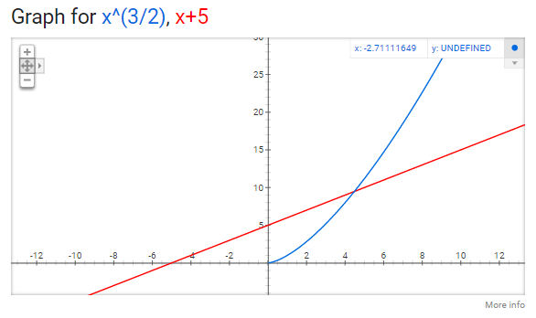
lead-acid batteries are in almost every car. Nickel-metal hydride batteries are a common rechargeable battery used in most households. Lithium-ion batteries are found in most laptops and phones. The most common battery type for UAVs is Lithium-Polymer (LiPo). The electrodes are made of graphite and lithium with a polymer being the electrolyte. The electrode pairs determine the voltage ranges a battery can provide. For LiPo cells, this is approximately 4.5V to 3V. However, these voltages aren't usually adequate. The UAV's electronics need a constant voltage to function, which can exceed 4.5V. More importantly, the motors need a higher voltage (as described previously). In order to reach these voltages, the cells need to be connected in a series such that the negative electrodes are joined with the positive ones leaving an empty pair of electrodes. LiPo batteries can be bought with just one cell or as many as 10 cells. As an example, a battery sold with 3 cells in a series will be a 3S battery, and 4 cells in a series would be a 4S battery.
Just as important as the total voltage a battery can provide is the total energy capacity of a battery. This is given in units of ampere-hours (Ah) or milliampere-hours (mAh). Essentially, a 1 Ah battery can provide 1 amp of electricity for 1 hour. With larger cell sizes, batteries can store more energy. When connected in series, however, all the cells must have the same capacity. When any one of them runs out of energy, the battery stops functioning. Cells connected in parallel (where the identical electrodes are connected) increase the capacity but not the voltage. This arrangement for UAV batteries is rare though. The amount of current a battery can supply is important. Larger motors and UAVs require more current. The cell construction factors into it. Batteries have a c-rating that specifies how much current the battery can supply in relation to the battery's capacity. A 5 Ah battery with a 10C rating can supply 50 amps of current. When selecting a battery, the number of cells needs to provide adequate voltage for optimal UAV operation. The c-rating needs to be high enough to meet the demands of the motors. The capacity has to be high enough to provide adequate flight time, but this has to be balanced with the weight that a higher capacity battery adds to the UAV.
LiPo batteries are commonly used since they can provide a large amount of power relative to their size. They do have one major drawback: volitility. They can be sensitive to impacts, being over discharged, or charged too much. When these conditions occur, the batteries can ignite. Because of these downsides, another battery chemistry, lithium iron phosphate (LiFe), is becoming increasingly popular. It is more durable, but it has a lower voltage range. When storing or charging LiPo batteries, it is advisable to keep them in a fireproof container. There is a debate over what voltage to store the batteries at. The common advice is that they ought to be stored at their nominal (50%) voltage, but this advice is disputed. More advanced chargers will have functions to charge or discharge the battery to this nominal voltage. Batteries also need to be cycled a certain amount of times before they reach their optimal efficiency and some chargers will have an option to cycle the battery automatically.
There are three important specifications to consider during BATTERY selection:
voltage,
max current discharge, and
capacity.
Each parameter is heavily dependent on the battery's chemistry.
If you want to build a racing drone, a higher voltage battery is desirable because it raises the top speed of your drone.
If you want to maximize flight time but aren't as concerned with performance, a higher voltage COULD be desirable if you can correlate some level of advantage to your energy density or efficiency.
3S and 4S (Ie. Xiro Xplorer or DJI Phantom) used the most for larger quadcopter and then 1S for small quadcopters (Ie. Drones that are largely considered toys.).
Rather than concern ourselves with finding an optimal voltage, we concerned ourselves with finding an optimum capacity and energy density. Because electrical power is equal to IV and thus stored energy is equal to IVt (where t is time) then a 4S battery with some capacity like say 4000mAh will have more energy. But it will also be more weight just like if you maintained a 3S voltage but increased the capacity. This is a key observation because increased weight means increased power required to hover. And remember that the power won't go up linearly with the weight of the drone. Power is related to thrust by a 3/2 power.
if energy and weight increase linearly we might get a situation like this. to the right of the intersection you may actually be LOSING flight time. However, from what we have seen, you actually gain energy DENSITY as you increase capacity. So we don't expect the situation to be so simple.

Slide 15
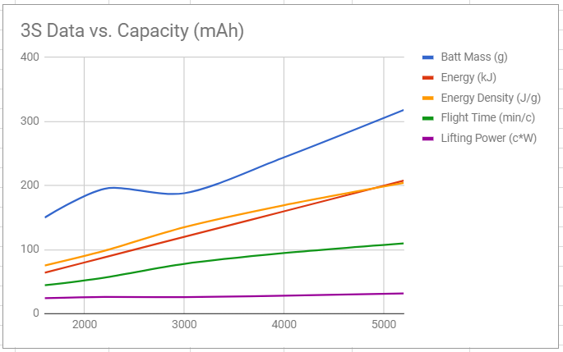
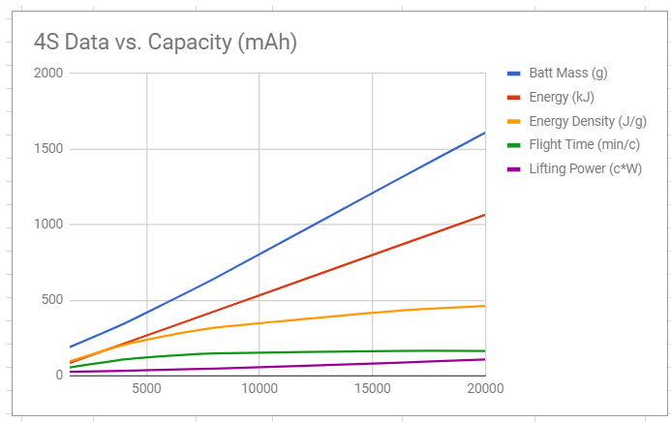
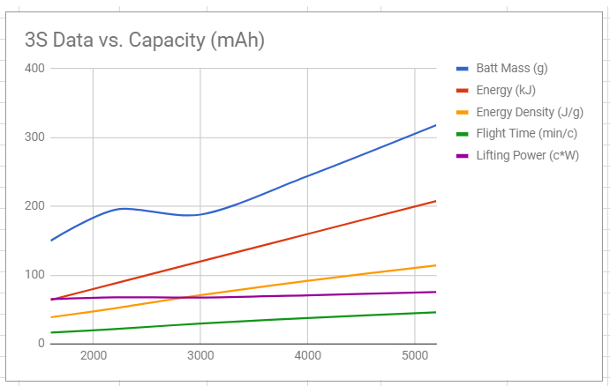
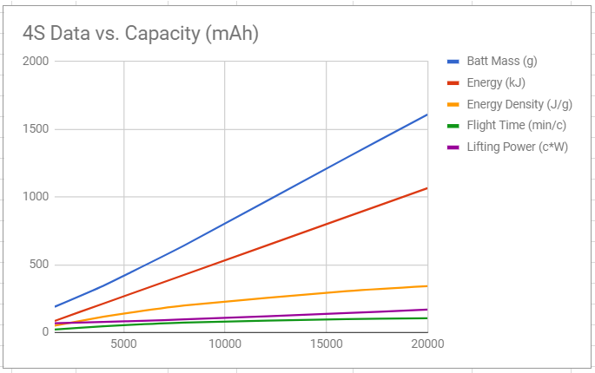
Power is equal to some constant of proportionality, c, (we will assume 1 for scaleability) multiplied by Thrust raised to the 3 halves power. And of course this assumes all other things being equal from air density to prop figure of merit to motor efficiency. The dip in the battery mass curve is because we actually found a battery of higher capacity and lower mass. Observe that when we factor in all of the necessary variables (to our knowledge) the flight time is shown to increase with the battery capacity size. However, it also seems to increase at a lower rate as the battery size gets bigger. This decrease in the rate of change suggests the flight time may peak at some capacity and then actually begin to descend. 3S lipo batteries don't seem to generally exceed roughly 6000mAh so we don't expect to see a huge swing down.
a graph comparing some parameters for 3S batteries of different capacities. These calculations assume a quad of mass 700g not including the battery.
4S is the floor for "high capacity" more or less.
a more pronounced decrease in the rate of increase in flight time.
1500g not including the battery.
the performance do a little better from battery to battery. But the overall flight time suffers because the total weight of the drone is of course significantly heavier.
increased battery size as related to flight time as you move up in battery sizes for a given weight, you can pretty much go for the biggest battery that will reasonably fit on your quadcopter in order to maximize your flight time. more than likely have to deal with physical constraints before have to deal with weight constraints.

Slide 16
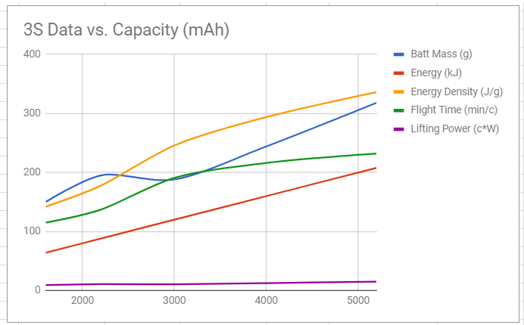
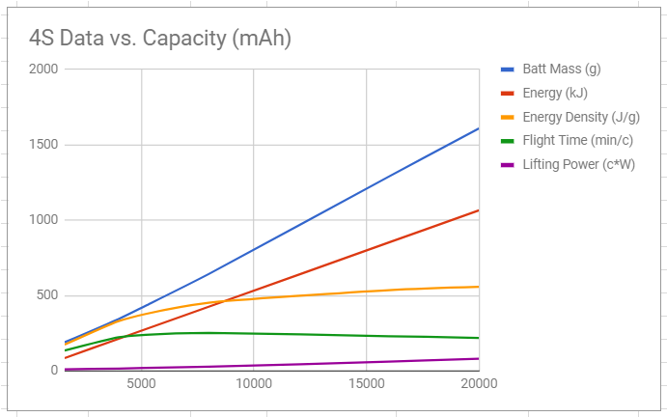
if we change the weight to 300g. For the bigger batteries this would basically just be a tiny quad lifting a HUGE battery
Here the flight time actually decreased from the 4S 16000mAh battery to the 4S 20000mAh battery.
verifying that the anticipated max discharge current from the battery will not exceed the rated discharge current capability. the max current rating for discharge in a steady state is the number of the C rating multiplied by the current-time capacity. For example, a 5,200 mAh 10C battery can discharge a maximum of 52A continuously. This is an important consideration as you build larger drones. You either need a higher capacity battery or a higher C rating as the drone gets heavier because it will require more current for a given voltage battery to turn the propellers. current is necessary to produce torque. Larger propellers will require more torque and thus current. Don't forget to consider your electronics. They will likely not draw very much current at all but all good designs cover their bases. If you plan to build a quadcopter with just the essentials to fly (no fpv or videography equipment) then you likely won't draw more than an 10W (About 1 Amp for a 3S battery) for a conservative estimate. We estimate our current phase 1 (flight control only) setup draws to order of half an Amp for all of the electronics put together.
First ensure that the motor is rated to operate with whatever battery voltage you choose. And last consider the efficiency of the motor when operating with that battery. matching the battery voltage (in its discharged state) as closely as possible to the voltage is necessary to produce 2x hover thrust (assuming you shot for a 2/1 max thrust to weight ratio) and is the most efficient because it will require the least PWM (Pulse Width Modulation). And in general, this will vary not only with the motor in question but with what propeller it is turning. Shorter propellers requiring higher rotational speeds will tend towards higher voltages (and thus higher voltage batteries by this logic) and longer propellers will tend towards lower voltages (and thus lower voltage batteries by this logic). the battery must be able to supply the voltage necessary for maximum thrust, whatever that is based on your desired max thrust to weight ratio.

Slide 17
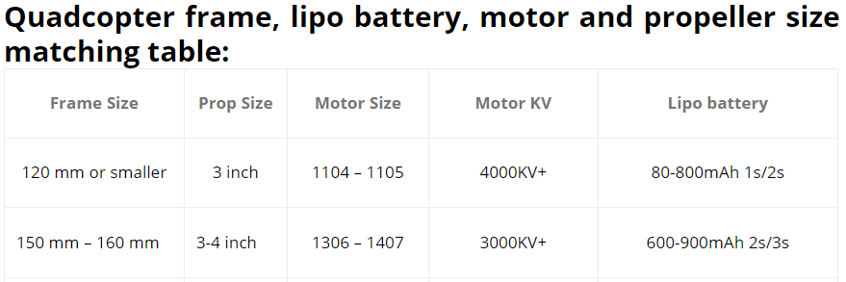
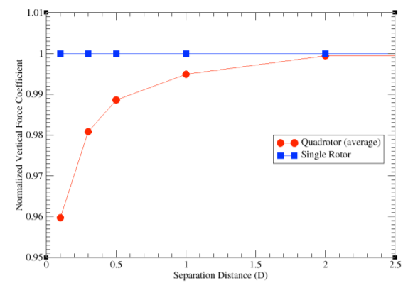
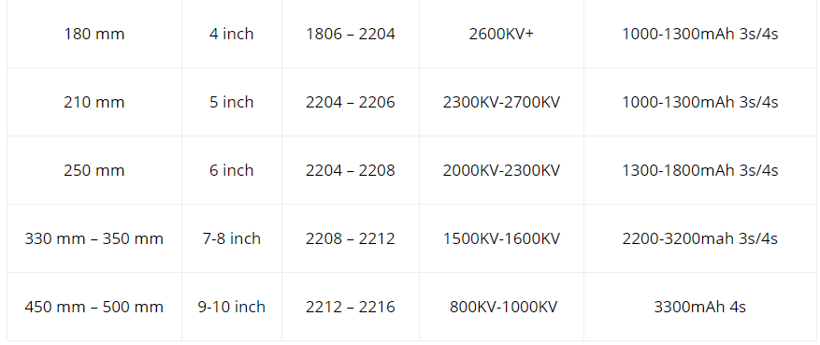
A study from NASA shows that propeller efficiency actually decreases when the propellers are placed too close together.
a 450mm frame with 10in diameter propellers. You can use Pythagorean's Theorem to easily derive the motor spacing to be about 12.5 inches. After subtracting out the radius of each propeller we get a spacing of .25D between the propellers. This isn't exactly ideal for efficiency but the decrease in efficiency is only about 3.5%. However, based on a other data, this is probably better than an increase propeller spacing with smaller 8 inch propeller for example. And convential wisdom may only gain a 1% increase in efficiency.
Finally, optimizing to maximize propeller efficiency to effectively zero losses due to propeller spacing is not worth it.
https://www.ecalc.ch/xcoptercalc.php

Slide 18
ELECTRONIC SPEED CONTROLLERS are essentially smart transistor switches. They have microcontrollers which receive a control signal from some external source such as a flight controller or a wireless receiver. Based upon the input signal, the microcontroller turns larger transistors on and off. These transistors are connected to the main power supply. When turned on, current flows through the motor. The microcontroller plays a critical role in not just the interpretation of the input signal but also in the closed loop control of the motor. In the case of brushless motors, it can detect the rotor position. This is important for two reasons. First, it determines the sequence in which the stators need to be energized. Second, it allows the microcontroller to measure the speed of the motor. By taking the latter into account, it can change the frequency of the current pulses to the motor in order to meet the specified throttle setting. More advanced ESCs can even have regenerative braking where a speed reduction charges the battery.
ESCs primarily have two specifications that are critical to the design process. The first is current capacity. Larger motors require higher levels of current. The ESC has to be able to handle these amounts with larger transistors and better cooling. There are two ratings: continuous current and burst current. Continuous current is the main specification with the burst current being a margin of safety. It is acceptable to have the continuous current rating match the motor rating. However, having a higher ESC rating gives an added margin of safety and durability. It is important to emphasize that the ESC current rating does not determine the current draw. The current consumption is ultimately set by the motor. The second ESC parameter is the input signal. Most ESCs accept some form of pulse width modulation, and the most common setting is to have a 490Hz update rate with a 1ms-2ms width range such that a 1ms pulse represents 0% throttle and 2ms is 100%.
variety of variations (for improved performance) on this scheme which are mainly determined by the ESC firmware and microcontroller. The firmware is the programming that implements all of the ESC functionality as accomplished by the microcontroller. It contains all of the different calculations that are required to interpret the input signal and control the motor. Sometimes it can be configured by the user for customization. The firmware is ultimately limited by the capabilities of the microcontroler. Microcontroller architectures have a wide variety of capabilities, and not all can support more exotic PWM schemes. The key is that the ESC needs to support the input signal scheme.
ESCs can also come with a variety of other options. They can have a variety of plugs for connections to a battery or to the motor. They can also have a battery elimination circuit (BEC), which can provide a steady voltage for other electrical components. Other improvements on the BEC are the SBEC and UBEC. These provide more power and reliability. ESCs without a version of the BEC are known as opto-ESCs. ESCs also have a voltage operation range, since the microcontroller and other electronics on the ESC are powered by a DC voltage regulator. This regulator can only upconvert or downconvert a certain range of voltages. Most ESCs are rated for use with 2S-6S LiPo batteries.

Slide 19
The FLIGHT CONTROLLER is the heart of a UAV. It combines the user's input with sensory data to stabilize and move the UAV (among other things). The real need for a flight controller comes from the inadequacy of a human to easily control all of the flight characteristics. For instance, if the center of gravity for the UAV is not balanced, all the motors being set at the same speed would have the UAV fly off-canter. A good flight controller allows for an easier and enjoyable flying experience.
From a hardware standpoint, a flight controller generally consists of a microcontroller, integrated sensors, and input/output connectors. the variation usually involves the processing capability and thus the number of available features. Most controllers include a gyroscope and accelerometer. The gyroscope senses the rotational motion of the UAV, and the accelerometer measures the three-dimensional forces exerted on the UAV. These allow for closed-loop feedback by the controller to optimize the motor output and account for changes in the center of gravity or the environment. Some models also allow for the integration of a GPS receiver and a magnetometer to let the controller know its position and heading.
Flight controllers have a variety of input and output signal connectors and schemes. The most basic is PWM, and this is almost a universal output for the ESCs. It can also be the input from the radio receiver. The main downside to this method is that each channel/parameter has to have a single connector. However, it is almost universally supported. PPM improves upon this by using more advanged analog techniques to reduce the number of cables needed. Analog signals, however, are more susceptible to external electronic interference. DSM and SBUS are digital varients that are also commonly used between the RX module and the FC. The FC can also connect to sensors using other digital protocols such as I2C, CAN, and UART. The important takeaway is that the FC needs to have both the software and hardware support for all of the other components you are including in your design.
The NAZA-M LITE is capable of advanced flight modes but comes at a cheaper cost than the regular NAZA. It does not need extensive programming—it is configured using a simple GUI—and keep the cost of the quadcopter down while gaining important flight modes including return-to-home.
a module that will receive wireless commands from a base station or remote control. There are three important aspects to deciding on a RX module. First, you need to determine how many channels you need. Channels are essentially control inputs to the flight controller. The number generally ranges from 4-9. Second, you need to check if the RX outputs are compatible with the FC. RX modules usually have PWM/PPM outputs. (As a side note, you could control the ESCs directly from the RX module if need be.) Going with DSM or SBUS allows for more channels with just a single cable. Finally, the radio frequency that the RX module works on is important. The most common frequency is 2.4GHz. In general, this works well. However, it can be susceptible to interference in urban areas where WiFi is prevalent. Lower frequencies allow for a longer range of communication at the cost of data bandwidth. For most amateur flights, range is not an issue, since the UAV has to be within sight.
The transmitter needs to match the RX module in both frequency and transmission protocol. Some brands are interoperable, but the safest choice is to have both be the same brand. Ergonomics for the controller only really apply if you plan on long flights. Considering that it is rarely beyond an hour or two, the controller features and reliability tend to be more important. These features can include multiple flight profiles for different UAVs, telemetry storage, external programming, transmit power, and number of channels.
Having LEDs on the quadcopter can aid the pilot in knowing the orientation of the quadcopter as well as provide additional information on the state of quadcopter like its flight mode or whether or if the battery voltage is so low the quadcopter should land as soon as possible.
If you want to carry any sort of payload like a gimbal and camera we suggest a frame size of 350mm (length from motor to motor) or larger. For other applications like first-person-view flying, you could go smaller than 350mm.

Slide 20
we nestled the FC, PMU, and receiver atop the PDB on the lower of the two levels of our frame center. We mounted the battery and the GPS antenna on the top. And we mounted our LED indicator on the back of the quadcopter on an arm near the center of the quadcopter so we could see it most easily. Remember to place your receiver such that its antenna (ours is loose and unsecured by a rigid guide) is not anywhere it could get hit by the propellers. Make sure to tie down any wires/cables - we used zip ties - to keep them secure and especially out of the way of the propellers.
You may not need to fully configure your FC at this time. The DJI Naza-M Lite is configured by connected it via USB to its companion software on a computer. Future configuration is both possible and likely so we made sure to put make the micro-USB port available when the quadcopter would be fully assembled.
Go through different combinations of signals on your transmitter and try to observe the speed changes in the motors. The motors should not be damaged running with no load and you shouldn't need to worry about max current and no-load either.
double-check the assembly so far, especially for propeller clearance. Zip tie any wires that need to be secured still. And then you should go ahead and finish assembling the quadcopter.
The ESC's and receiver should already be configured. However, the FC configuration may still be pending changes.
charge your battery (if you have not started already). Remember that LiPo batteries should always be charged in a fireproof bag and under supervision for safety. You do not have to stare at the battery for 5 hours. But you should be present in so much as you could quickly respond should the battery puff, smoke, or ignite.
attach your propellers, plug your battery in, and perform any pre-flight calibrations. An example of a pre-flight calibration is compass calibration. You may need to hold your quadcopter in different orientations and spin around with it to calibrate its compass.
Follow the appropriate sequence for plugging your battery in. (This likely will include ensuring your throttle stick is all the way down at zero or simply at the neutral center if spring-loaded.) Be very careful when executing the initial power-up of a UAV. Follow all available instructions regarding pre-flight protocol and be vigilent to avoid any accidents due to unexpected propeller motion.
Assembly

Slide 21
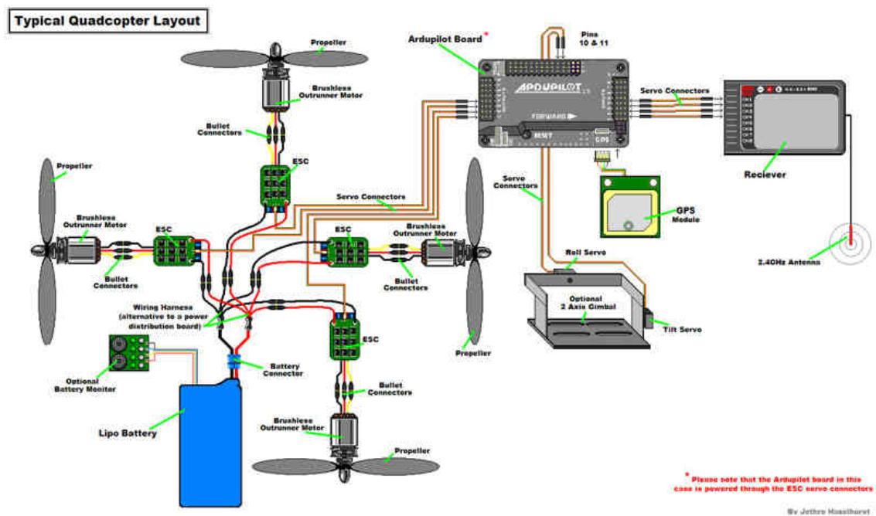
The connections can be made using wires, but this has two disadvantages. First, the additional connectors and wires add extra mass to the UAV. Second, the wiring can interfere with both the electronics and the additional control wiring between components. A power distribution board (PDB) is probably the better approach. (Note that in the diagram above they use a wiring harness instead and the flight controller is actually powered through the ESC leads.) A PDB is essentially a printed circuit board, which is made of some insulating material like fiberglass that has copper (or another conductive metal) placed in cutouts on the surface and then covered such that only a few key points are exposed. These exposed areas are usually referred to as pads. At these points, you attach connectors or wires to the copper traces via soldering. choice of power distribution may also come with additional electronic components like a voltage monitor, current monitor, and voltage regulator for supplying a certain voltage level.
A quadcopter's electronics will require a steady voltage level like 3.3V or 5V. The battery itself cannot meet these needs. Not only does the battery voltage decrease as the state of charge drops but the current draw from the motors can also make the voltage at the battery terminals sag (larger current through the internal resistance of the battery results in a larger voltage drop before the terminals). The solution is a voltage regulator. A regulator may possibly be called a power monitoring unit, linear regulator, switching regulator, or cascade regulator. Types of switching regulators are buck converters (steps down voltage only), boost converters (steps up voltage only), or buck/boost converters (steps voltage up or down) depending on the circuitry involved. Linear regulators are the least efficient, but are the cheapest. Switching regulators are the most common due to their lower losses in energy when converting between voltages. Sometimes, your design might require multiple regulators in order to supply the correct voltages. Some devices may have a regulator already built-in. Like with the ESCs, the available current supply is an important figure. If it is too close to the current required by the electronics, the regulator can have a decreased operational life or even fail with catastrophic results. A higher current rating results in increased mass and cost.

Slide 22
Laws & Regulations
https://egazette.gov.in/WriteReadData/2021/229221.pdf
https://www.civilaviation.gov.in/sites/default/files/2023-10/Drone%20%28Amendment%29%20Rules%2C%202022%20dated%2011%20Feb%202022_0.pdf
https://www.civilaviation.gov.in/sites/default/files/2024-04/Drone%20%28Amendment%29%20Rules%2C%202023.pdf
The unmanned aircraft system shall be categorized
into the following three categories, namely:––
(a) aeroplane;
(b) rotorcraft; and
(c) hybrid unmanned aircraft system.
further into
(a) remotely piloted aircraft system;
(b) model remotely piloted aircraft system; and
(c) autonomous unmanned aircraft system
(1) No type certificate shall be required for manufacturing or importing an unmanned aircraft system.
(2) No type certificate shall be required for operating the following, namely:––
(a) a model remotely piloted aircraft system; and
(b) a nano unmanned aircraft system.
All drones except nano require a licensed pilot and permit. Altitude and speed restrictions also vary depending on the category of the drone.
No person shall operate an unmanned aircraft system without first registering it on the digital sky platform and obtaining a unique identification number.
It shall be the responsibility of the person operating an unmanned aircraft system to ensure that such unmanned aircraft system conforms to a valid type certificate
compulsory safety measures:
(a) ‘No Permission – No Takeoff’ hardware and firmware;
(b) Real-time tracking beacon that communicates the unmanned aircraft system’s location,
altitude, speed and unique identification number; and
(c) Geo-fencing capability.
No remote pilot licence shall be required for ––
(a) operating a nano unmanned aircraft system; and
(b) operating a micro unmanned aircraft system for non-commercial purposes.
(a) Nano unmanned aircraft system: weighing less than or equal to 250 grams;
(b) Micro unmanned aircraft system: weighing more than 250 grams, but less than or equal to 2 kilograms;
(c) Small unmanned aircraft system: weighing more than 2 kilograms, but less than or equal to 25 kilograms;
(d) Medium unmanned aircraft system: weighing more than 25 kilograms, but less than or equal to 150 kilograms; and
(e) Large unmanned aircraft system: weighing more than 150 kilograms.
No person shall replace the flight control module or remote pilot station of an unmanned aircraft system whose serial number is linked to such unmanned aircraft system’s unique identification number, without first updating, on the digital sky platform, the unique serial number of the new flight control module or remote pilot station, within a period of seven days from the date of such replacement or before operating such unmanned aircraft system, whichever is earlier.
Airspace Map - dynamically updated
(1) No person shall operate an unmanned aircraft system in a red zone or yellow zone without prior permission.
(2) No prior permission shall be required for operating an unmanned aircraft system in a green zone

Slide 23
A person may transfer an unmanned aircraft system to another person by way of sale, lease, gift or any other mode, after providing requisite details of the transferor, transferee and unique identification number of the unmanned aircraft system in Form D-3 on the digital sky platform, along with the fee as specified in rule 46.
Where an unmanned aircraft system registered in a person’s name is either permanently lost or permanently damaged, he shall, on arriving at a reasonable conclusion that it is so lost or damaged, apply for deregistration of such unmanned aircraft system by submitting an application in Form D-3 on the digital sky platform along with the fee as specified in rule 46.
Prohibition on carriage of arms, ammunition, explosives and military stores, etc and Carriage of dangerous goods
No person operating an unmanned aircraft system shall violate the right of way of a manned aircraft and shall remain clear of all manned aircrafts.
No later than forty-eight hours after an accident involving an unmanned aircraft system takes place, the remote pilot of such unmanned aircraft system shall report the accident to the Director General through the digital sky platform.
The following persons shall not require a type certificate, unique identification number, prior permission and remote pilot licence for operating unmanned aircraft systems for research, development and testing purposes, namely:––
(a) any research and development entity under the administrative control of, or recognised by, the Central Government or State Government or Union Territory Administration;
(b) any educational institution under the administrative control of, or recognised by, the Central Government or State Government or Union Territory Administration;
(c) any Startup recognised by the Department for Promotion of Industry and Internal Trade;
(d) any authorised testing entity; and
(e) any unmanned aircraft system manufacturer having a Goods and Service Tax Identification Number:
Provided that such unmanned aircraft system operations takes place within a green zone and within the premises of the person where such research, development and testing is being carried out or within an open area in a green zone under such person’s control.
Operating drones is also barred within 5 km of international airports at Mumbai, Delhi, Chennai, Kolkata, Bengaluru and Hyderabad, and at a distance of 3 km from the perimeter of any civil, private or defence airport.
Drones cannot be flown within a distance of 25 km from international borders, which includes the Line of Control, and in the vicinity of military installations or areas where military activities take place (unless clearance is obtained from the local military facility).
Under the rules, individuals and companies are required to obtain the DGCA’s approval to import, manufacture, trade, own or operate drones.
(1) The provisions of the Motor Vehicles Act, 1988 (59 of 1988) and rules made thereunder shall apply, mutatis mutandis, to the third party insurance of unmanned aircraft system and compensation in case of damage to life or property caused by such an unmanned aircraft system: Provided that a nano unmanned aircraft system may operate without third party insurance.
(2) A person operating a unmanned aircraft system may use an insurance product specially designed for such operations, as and when such insurance product is approved by the Insurance Regulatory and Development Authority of India.

Slide 24
Indian Industry
With the aim of making India a drone hub by 2030 and a $30 billion
industry, the Government of India has taken several steps to promote
India’s budding drone industry. These include the liberalised Drone Rules,
2021, rationalised norms for drone pilot, establishment of drone schools,
and the Product Linked Incentive (PLI) scheme launched in 2021 to boost
manufacturing in the drone industry.
The Production-Linked Incentive (PLI) Scheme for drones and drone components has been notified on 30 September 2021 to promote the manufacturing of drones and drone components in India. The details of the PLI scheme are as follows:
i. An incentive of Rs. 120 crore has been provided for Indian manufacturers of drone and drone components on the basis of their value addition in India, calculated as the annual sales revenue from drones and drone components (net of GST) minus the purchase cost (net of GST) of drone and drone components. The incentive is spread over three financial years commencing from 2021-22. It is nearly double the combined turnover of all domestic drone manufacturers in FY 2020-21.
ii. The PLI that can be claimed by a manufacturer is 20% of the value addition by such manufacturer. The PLI rate is constant at 20% for all three years, one of the highest among PLI schemes.
iii. Minimum value addition is specified as 40% of net sales, instead of 50%.
iv. Eligibility norm for Micro, Small and Medium Enterprises (MSME) and startups is specified as Rs. 2 crore of annual sales revenue for drone manufacturers and Rs. 50 lakhs of annual sales revenue for drone component manufacturers. The coverage of the scheme includes developers of drone-related software also.
v. PLI for a beneficiary is capped at 25% of the total annual outlay to allow widening of the number of beneficiaries.
vi. In case a manufacturer fails to meet the threshold for the eligible value addition for a particular financial year, the manufacturer will be allowed to claim the lost incentive in the subsequent year if the manufacturer makes up the shortfall in the subsequent year.
The Ministry of Civil Aviation has disbursed an amount of Rs. 30 crores (approximately) to the beneficiaries during FY 2022-23 under the PLI Scheme for Drones and Drone Components.
A provisional list of 23 PLI beneficiaries was released on 6th July 2022. The beneficiaries include 12 drone manufacturers and 11 drone component manufacturers.
The drone market in India is projected to have a total turnover of up to $ 150 Bn by 2026. As per NITI Aayog’s estimate, the drone market is expected to grow to $50Bn in next 15 years.
The drone market in India is projected to stand at $13 Bn by 2030, up from $2.71 Bn in 2022, positioning India as a key player in Asia Pacific (APAC)
The global market for military drones is forecasted to grow from $11.73 billion in 2022 to $30.86 billion by 2029, there is immense potential to export drones. Turkey and Iran are leading exporters of military drones.
The Government of India has floated schemes like Credit Guarantee Fund Trust for Micro and Small Enterprises (CGTMSE) to catalyse flow of institutional credit to Micro & Small Enterprises (MSMEs). the lack of risk appetite by banks in extending credit to them. banks seek collateral before extending credit to start-ups which is not always possible for start-ups to provide. India has a huge drone market wherein government is the biggest consumer, a big challenge is that payment cycles are delayed to 120 days or more at times. This, in addition to risk aversion displayed by banks, makes it challenging for start-ups to survive and manage their working capital cycle.

Slide 25
All kind/type of drones/UAVs were earlier controlled/restricted for export under the category 5B of the SCOMET (Special Chemicals Organisms Material Equipments and Technology) list under Appendix 3 of Schedule 2 of the ITCHS classification of Import and Export Items. This list deals with the category of items that are subject to specific regulations due to their potential dual-use nature—meaning they can have both civilian and military applications.
the SCOMET policy of drones/UAVs meant for civilian use has been amended vide DGFT Notification No. 14 dated 23.06.2023 to simplify and liberalize the policy for export of drones/UAVs. The export of Drones/UAVs not covered under the specified categories in SCOMET list and capable of range equal to or less than 25 km and delivering a payload of not more than 25 kgs (excluding the software and technology of these items) and meant for only civilian end-use, will now be subject to General Authorization for Export of Drones (GAED), a onetime general license valid for 3 years. This would further facilitate the Drone/UAV manufactures/industry to export drones with ease.
Investments in the drone segment totalled over $83 Mn from January 2016 to November 2023. Notably, two startups, ideaForge ($47.3 Mn) and Garuda Aerospace ($25 Mn), have collectively secured 87% of the total sectoral funding during this period.
Garuda Aerospace creates customised drones for various applications like event photography, agricultural surveys, reconnaissance, and surveillance. Product range includes agri mapping, surveillance drones, solar panel cleaning, seed dropping, loudspeakers, UGVs, and fixed-wing vertical take-off and landing (VTOL) drones, etc.
Similarly, Ideaforge makes UAV systems for inspection, surveillance and mapping. Its solutions are used across sectors such as defence, homeland security, mining, construction, agriculture, energy and utilities.
Other noteworthy startups with significant funding include Skylark Drones, Skye Air Mobility, and Preimage.
The Ministry of Defence (MoD) currently supports India’s military drone ecosystem through its programs. For example, the Innovations For Defence Excellence (iDEX) initiative provides grants to support the development of military-grade products, including drones. iDEX floats open challenges based on the specific requirements of the armed forces. Start-ups then pitch their ideas to meet these requirements and those with the best pitch win a grant to develop their product. Today, several military drones are being developed through this route. Drone start-ups have also benefitted from the Technology Development Fund. This scheme extends financial support along the same lines as iDEX to upgrade weapons systems and develop innovative technologies for defense applications. Currently, iDEX only provides initial funding, capped at Rs. 1.5 crores (about $182,000), which is grossly inadequate to scale-up drone production.
the Indian Air Force’s Mehar Baba Competition, which is aimed at encouraging the development of swarm drones, provided the initial push for military drones in India. Organized between 2018 and 2021, the first edition of this competition saw start-ups from across the country showcase their drones. A panel of domain experts guided these start-ups through the competition and evaluated the performance of their drones based on the parameters laid down by the Air Force. A second edition of the Mehar Baba Competition was launched in 2022.
Similarly, the Indian Army, in collaboration with the Drone Federation of India, launched the Him Drone-a-thon program in 2022. The program intends to provide India’s drone ecosystem with opportunities to develop its capabilities to meet the Army’s requirements.
a drone used in the agriculture sector to spray pesticides can cost anywhere between Rs 5 lakh and Rs 10 lakh; a survey-mapping drone can cost between Rs 8 lakh and Rs 12 lakh; defence ones can cost anywhere from Rs 5 lakh to Rs 1 crore, depending on specifications and endurance

Slide 26
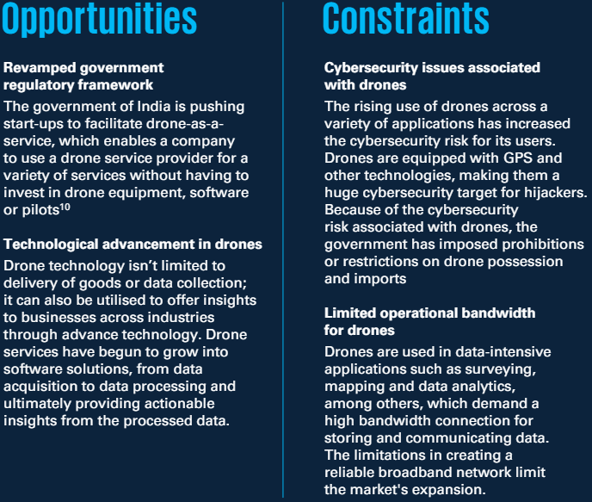
The drone services market is divided into three categories - drone maintenance, repair and overhaul (MRO), drone platform services and drone training and education services. The drone service market in India was valued at USD130.4 million in 2020 and is expected to reach USD4,918.9 million by 2030, at a Compound Annual Growth Rate (CAGR) of 44.4 per cent. Drone service market segment, drone Maintenance, Repair, Overhaul (MRO) services and drone training and education services are predicted to grow at a CAGR of 46.8 per cent and 45.2 per cent, respectively, from 2020 to 2030. By 2030, the combined share of these two segments is expected to be 25 per cent.
Planning surveys and mapping- INR10-12 thousand per sq. km
Construction monitoring- INR2.5 thousand per km for road construction survey
Earthworks management- 15-30 days for surveying 100-acre job site
Agriculture crop monitoring and spraying- INR1500-1800 per acre for spraying
Industrial asset maintenance and sustainability- 100 thousand per chimney inspection using crane
IN-SCOPE
Consumer drones
Prosumer drones under 5 kg (including high-end drones for professional use acquired through consumer distribution channels)
Hobbyist drones / toy drones
OUT-OF-SCOPE
Military drones
Commercial drones / industrial drones
Radio-controlled two-wing aircraft and helicopters
Accessories (not included in the original package, cameras, lenses, handles, spare parts, etc.)
With the global drone market projected to reach $54 billion by 2025, India stands to capture a substantial share, potentially reaching $4.2 billion and expanding to $23 billion by 2030, as per the EY-FICCI report 'Making India the drone hub of the world.'
The Drones market in India is projected to generate a revenue of US$27.0m in 2024.
This market segment is expected to experience an annual growth rate of 5.96% (CAGR 2024-2028).
When compared globally, in China leads the way in terms of revenue generation, with a staggering US$1,526.0m in 2024.
In relation to the total population of India, the per person revenue in the Drones market is estimated to be US$0.02 in 2024.
Looking ahead, the volume of the Drones market in India is projected to reach 75.8k pieces units by 2028.
Furthermore, there is an expected volume growth of 6.6% in 2025.
Interestingly, the average volume per person in the Drones market is anticipated to be 0.0pieces units in 2024.
India is experiencing a surge in the adoption of drones for agricultural purposes, revolutionizing farming practices in the country.
The annual sales turnover of the Indian drone manufacturing industry may grow from approximately Rs 60 crore in 2020-21 to approximately Rs 900 crore by 2024-25.
five key pillars that will allow India to be a drone hub in the next few years: Ease of Doing Business (Drone Rules 2021), financial incentives (PLI scheme), government as market maker (procurement by government), export liberalisation and domestic industry promotion (Import prohibition).
The map published on September 24, 2021 opened nearly 90 per cent of Indian airspace as a green zone for drones flying up to 400 feet.
the interim budget on February 1, 2024, raised the allocation for PLI scheme for drone and drone components to Rs 57 crore for the fiscal year 2024-25, up from Rs 33 crore in FY23.

Slide 27
The biggest challenge that India faces is the lack of a component ecosystem for drones due to which the domestic manufacturers have to depend on imported materials. The government's import ban aimed at promoting indigenous drone manufacturing excluded components from the restriction. A lot of investment has started happening in the local ecosystem and it is going to shape up in the next couple of years. IdeaForge, India’s biggest drone company, is working with various vendors to indigenise a lot of subsystems of drone technology. It says quite a lot of its procurement already happens from India. It has also invested in a company that is producing propellers for it.
It is equally important to foster a talent pool for flying these UAVs and establishment of testing facilities. There is no official testing facility in the country. a drone that can cover 100-200 km, there is no dedicated testing place in India.
One of the dangers of the PLI scheme for drone industry is lack of checks and balances. if there are no checks and balances, one would have substandard quality products getting benefits as well. Demanding an expansion of the PLI scheme, the industry also asks for production-linked incentives to be linked with service-linked incentives. While there are only 35 to 40 DGCA-licensed drone manufacturers in the country, there are 3.5 lakh drone users in the country.
the lack of research and development (R&D) being undertaken by drone start-ups. These start-ups are often short on capital and are reluctant to expend their scant resources on developing products the Indian armed forces are unsure about procuring. To encourage R&D, the armed forces need to assure drone start-ups of orders following the development of their products. For start-ups, even one order makes a world of difference, allowing them to scale-up production, further develop their products, and even incorporate more indigenous components. Apart from this, the Indian armed forces should formulate their requirements more efficiently—drone start-ups complain that the military often wants to procure UAVs with advanced features, but at a low cost.
there is a dearth of qualified drone pilots and
Unmanned Aircraft Vehicle (UAV) engineers.
Lack of sufficient number of Remote Pilot Training Organisations (RPTOs) - There are currently 28 RPTOs in the country which may be insufficient to cater to the growing demands of the industry. We acknowledge that announcements in Union Budget 2022-23 have been made on drone skilling courses proposed to be offered in select Industrial Training Institutes (ITI) in all states, but we understand that they are yet to be started.
the cost of training by RPTOs is on the higher side for a five day course i.e., sometimes ranging from Rs 8000-11000 for a day.
the Indian private sector currently lacks the capacity to manufacture key components used in drones and imports them instead. To address this, the government did launch a Production-Linked Incentive (PLI) scheme in 2021, aiming to incentivize the indigenous manufacture of drone components across the board. However, the scheme only has an outlay of Rs.120 crores ($14.5 million) where each beneficiary receives a small piece of the pie. Hence, while the PLI scheme will help in the indigenization of military drones—several defense start-ups are already benefitting from it—there is scope for the government to increase its outlay and aid more start-ups
shortfall in the availability of high-quality components in the Indian market for manufacturing drones as well as the development and implementation of a robust unmanned traffic management (UTM) system to manage the increasing number of drones in the airspace and prevent collisions remains the major challenges.
some cities such as Mumbai and Delhi, which are also significant economic zones, are largely red zones, and therefore, pose challenges for the drone industry to conduct research and development, use drones for aerial photography, delivery purposes etc.
the local police officers are not aware of the Digital Sky platform. This can lead to inadvertent consequences including limiting police authorities’ capabilities in utilising the benefits of the Digital Sky Portal, prohibiting flying of drones/seizure of drones despite an airspace being in green zone or without updating the zone appropriately on the Digital Sky platform.
the sector requires a lot of effort to remove barriers to awareness, education, and technology access in rural areas. A persistent issue facing the industry is the lack of qualified drone pilots.
regulatory hurdles, such as incomplete airspace information and the absence of Beyond Visual Line of Sight (BVLOS) regulations and certifications, complicate drone operations.

Slide 28
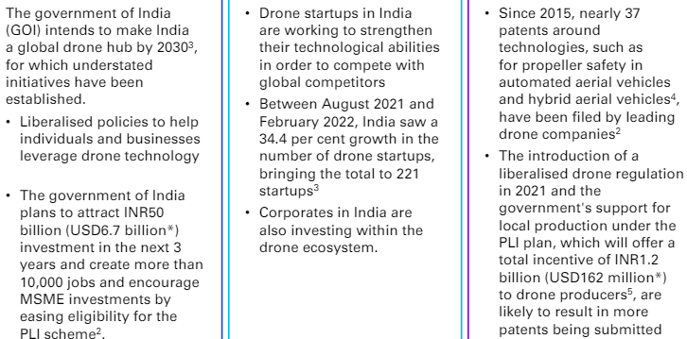
Countries all over the world are relaxing regulations on beyond visible line of sight (BVLOS) operations, which define the ease of operating an unmanned aircraft without a remote pilot while maintaining a visual line of sight on the UAVs.
China has a maximum 400-foot above-ground level limit, with UAS operators required to buy insurance for UAS covering liability for third parties on the ground. The airspeed of the UAS is limited to 100 kilometers per hour. Also, the UAS operators are required to record the flight data in a real-time online systems. Leading UAS manufacturing companies based in China currently make up the majority of the global UAS market. And this is due to the rapid innovation, development of Unmanned Traffic Management and continuous government investment.
The U.S. has also witnessed exponential growth in drone usage post 2015 due to liberalized government policies resulting in significant investments. The U.S. policies, which allow higher altitude flights at speeds no faster than 100 miles per hour, heavier payloads with few restrictions, and a streamlined online process, have resulted in positive performance in the American market. The U.S. has recorded more than 900 startups and big corporates within the drone industry. However, due to restrictions imposed on the U.S. armed drones, China has swooped in to take the lead in the military drone market, which the U.S. is trying to recapture .
All the above-mentioned factors are reflected in the amount of money invested in the industry. This capital is further reflected in the innovations driven by companies from these two countries.
India is a major importer of drones, accounting for 22.5 per cent of total global drone imports. Though most drones are employed for military activities, commercial drones are growing increasingly popular. With a total value of over USD900 million, the commercial end-use drone sector is predicted to exceed the military industry. And by 2025, India is forecasted to be the world’s third-largest drone market.
The union government announced the Drone Shakti scheme in its 2022 budget statement, with the goal of facilitating and promoting drones as a service through companies.
To promote the use of kisan drones, the GOI is providing financial incentives. For instance, Farmers Producers Organisations can receive a up to 75 per cent subsidy of the cost of an agricultural drone.
India has forged several key partnerships and collaborations in the global drone ecosystem. The collaboration between India's Directorate General of Civil Aviation (DGCA) and the United States Federal Aviation Administration (FAA) has been pivotal in aligning regulatory standards and fostering international drone operations. India's collaboration with the Drone Alliance Europe has facilitated knowledge exchange and regulatory harmonisation, promoting global interoperability. Additionally, partnerships with organisations like the International Civil Aviation Organization (ICAO) have enabled India to contribute to shaping global drone regulations, ensuring a cohesive framework for safe and efficient drone operations worldwide.

Slide 29
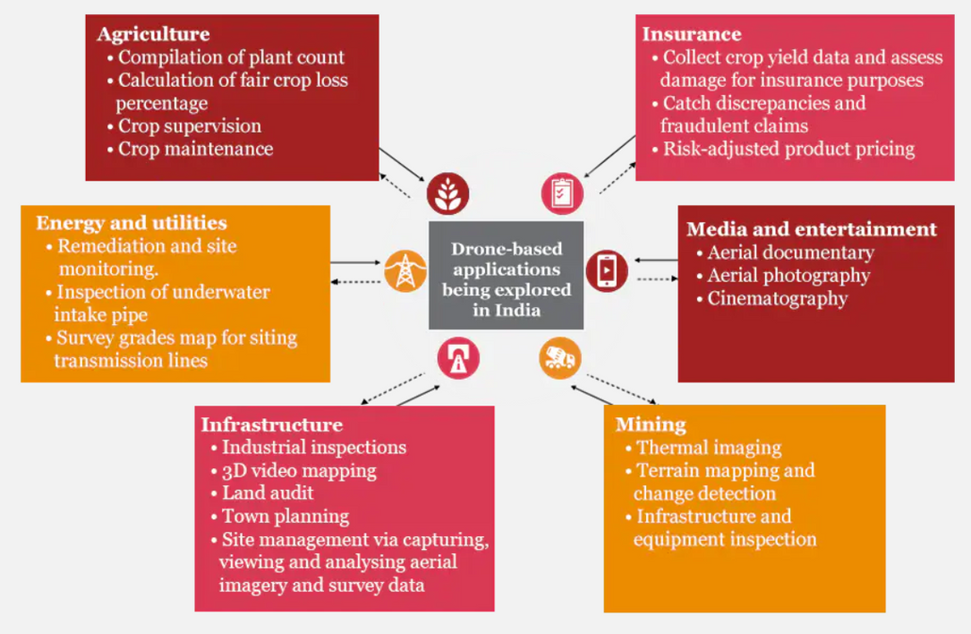
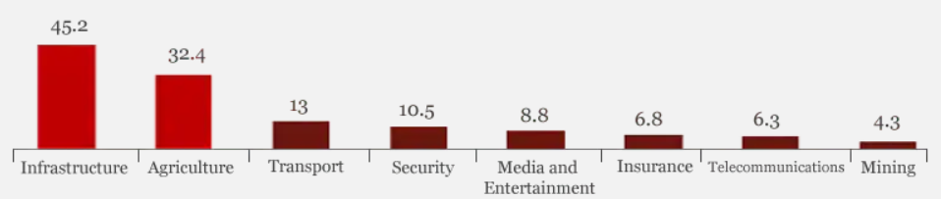
the market size has also been growing. It was estimated that by the year 2030, the Indian drone market in India would reach 2.5 trillion Indian rupees. Compared to a decade ago in 2020, the market size was just 29 billion rupees. The biggest contributor to the drone market by 2030 was estimated to be the defense sector.
As of November 2023, there were around 13 thousand drones registered in India. This was a large increase compared to the previous year, with the number of registrations growing more than 2000 percent during 2021-23. During the same period, Directorate General of Civil Aviation (DGCA) authorized 70 drone pilot training facilities in the country, with close to eight thousand pilots trained.
In financial year 2023, investments in drone startups in India was close to 50 million U.S. dollars. It was almost double the amount for 2022. The drone manufacturing sector in India has strong government backing with 1.2 billion Production Linked Incentive (PLI) scheme during the same year.
As of July 2023, there were close to 5.1 thousand certified drone pilots in India. It was a huge increase in comparison with the previous year.
90% of airspace as Green Zone and allowed the operation of drones up to a vertical distance of 120 metres. To promote the growth of the industry, the Rules abolished the need for registration and security clearances for operating non-commercial drones in the Green zones.
Outside the military and security applications, more and more drones have been used in civilian capacities. In the commercial setting, drones have been used for delivery, including vaccines during the coronavirus pandemic, waste management, and crop spraying. In the consumer section, people started using drones for filming and flying them as a recreational activity. It is possible that drone sport could become an e-sport activity in the future.
the Indian UAV market is poised to grow at a CAGR of 18% during 2017–23 in terms of revenue. Although these numbers will continue to be led by the long range UAV segment, medium and mini-UAVs are also poised to register healthy growth. Data provided by the Stockholm International Peace Research Institute (SIPRI) indicates that with 22.5% of the world’s UAV imports, India tops the list of drone-importing nations. Again, these are numbers primarily for military purposes, and commercial drones are showing healthy growth as well. According to study conducted by BIS Research, it is predicted that the market for commercial end-use of drones might supersede the military market by 2021, cumulatively hitting approximately 900 million USD.

Slide 30
India’s agricultural sector, contributing 15.4% to the GDP while engaging 47% of the labor force, presents a prime opportunity for drone utilization. As in-depth research shows, drones can significantly improve efficiency and profitability in agriculture by providing real-time data for precision farming practices. Considering the high amount of labor force that goes into agriculture as well as the percentage of GDP that relies on agriculture, India is among the top locations where agricultural drones can have an immediate and vast impact, especially as urbanization rates climb and there are less people willing and [avail]able to work on the countryside. As the BBC suggests, drones could indeed be the future of Indian farming, especially considering its early investment into the Kisan Drone.
India is also subject to natural disasters such as droughts, flash floods, widespread and destructive flooding from monsoonal rains, and earthquakes. Given the frequency of these natural hazards, drones can have a high impact through inspections of buildings at risk, surveying lands before and after a natural disaster, or search and rescue in the event of floods and earthquakes.
the highly concentrated population (1.4 billion) in a sizeable amount of land (3.3 million km²) also means a need for construction and infrastructure projects, which opens the door for mapping and surveying opportunities. As with other densely populated countries, the use of drones to avoid traffic means that drone delivery will also have vast potential once necessary regulations take effect to protect the people below. Additionally, regions that lack infrastructure (i.e. the opposite of traffic jams) or are cut off by mountains or rivers (especially after a natural disaster) will also benefit greatly from deliveries by drone.
Flying Height: Drones operate at 50-100m; For agricultural spray, we can keep it around 2-3m above the crop canopy and special authorisation is needed beyond 50m.
License Requirements: For non-commercial use, no pilot license is required for nano and micro drones under new government rules.
Weather Conditions: Drones can fly in any weather, but image quality may suffer during rain.
Distances Covered: Depends on drone capability; fixed-wing drones cover more area per flight (e.g., 50 min flight time covers up to 12 km).
Drone Cost: Standard drones for public use start at Rs. 3.45 lakh; agricultural drone ranges around Rs. 7.5 lakh- 12.0 lakh for basic models and start at Rs. 15.0 lakhs for high-tech agricultural drones.
India has a very high concentration of medium-sized drone companies. The highest percentage of companies (33%) fall in the 51-200 employees range rather than the 1-10 employees range (27%) or the 11-50 employees range (27%).
In 2023, India’s drone market reported an optimism level of 7.8, which is higher than the optimism of the previous year (7.0) and much greater than the global average of 6.6. the Indian drone market considers rule-making authorities the leading market driver. And on average companies perceived substantially positive changes in regulation (7.1), which is perhaps one of the reasons for the high optimism in the market.
Roughly 21% of companies are DSPs (Drone Service Providers), while an equal 21% carry out Drone Training & Education services. These are closely followed by Software Manufacturers (18%), which falls in line with common perceptions about India being a strong market for software programmers. Finally, in a close but certain fourth place are Hardware Manufacturers (12%)
the number one concern reported by companies is public acceptance. Competition appears within the top three challenges, fitting the consequences of having a large population and a varied drone market. however, drone companies in India seem to be astoundingly optimistic.

Slide 31
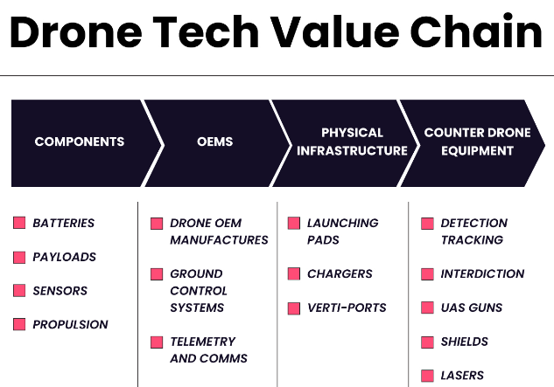
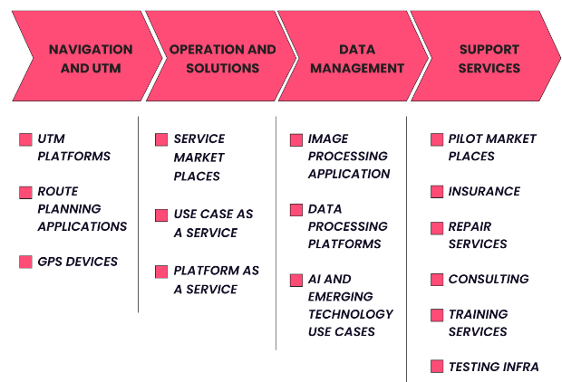
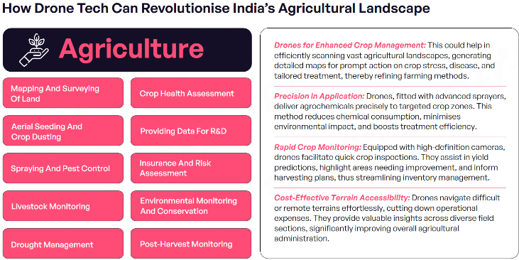
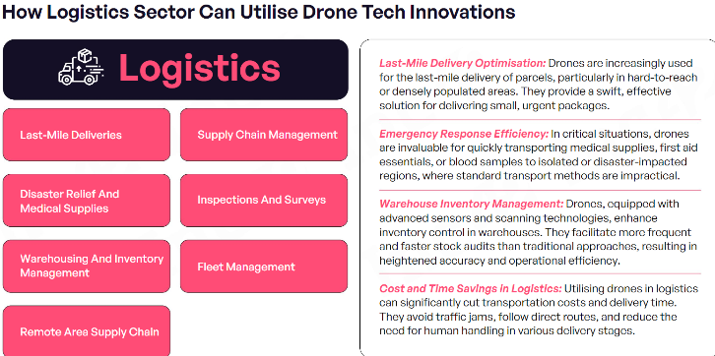

Slide 32
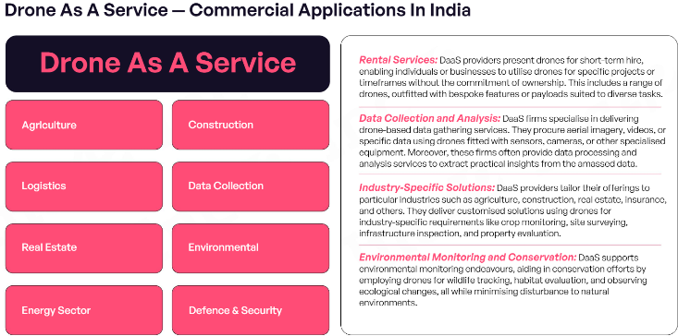
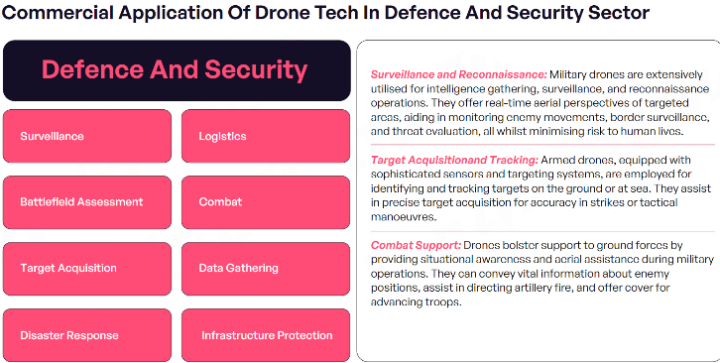
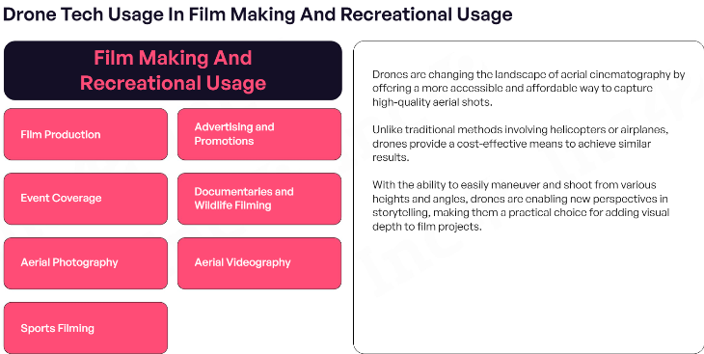


Slide 33





